Slide 1
Friends & Templates
Instructor: usman.wajid@nu.edu.pk

Slide 2
this Pointer
Every object of a class maintains a (hidden) pointer to itself called this
this is a reserved word
When an object invokes a member function
the this pointer is referenced by the member function

Slide 3
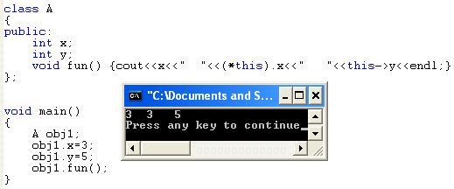
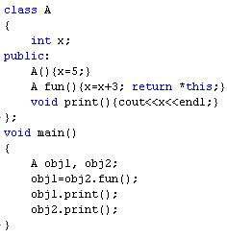
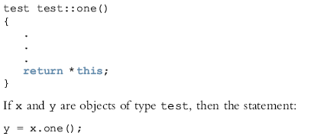
this Pointer
Copies the value of object x into object y
8
8

Slide 4
Friend Functions of Classes
A friend function of a class is a nonmember function of the class, but has access to all the members (public or non-public) of the class.
To make a function friend to a class
The reserved word friend precedes the function prototype in the class definition

Slide 5
Friend Functions of Classes (continued)
The word friend appears only in the function prototype (in the class definition), not in the definition of the friend function
When writing the friend function definition
The name of the class and the scope resolution operator are not used

Slide 6
Example
class Employee
{
private:
string name;
double salary;
public:
Employee();
Employee(string n, double s);
string getName();
double getSalary();
};
Employee::Employee() : name(""), salary(0) {}
Employee::Employee(string n, double s): name(n), salary(s) {}
string Employee::getName() { return name; }
double Employee::getSalary() { return salary; }
void raiseSalary(double amount, Employee& e)
{
e.salary += amount;
}
Cannot access private member of Employee

Slide 7
Example
class Employee
{
private:
string name;
double salary;
public:
Employee();
Employee(string n, double s);
string getName();
double getSalary();
};
Employee::Employee() : name(""), salary(0) {}
Employee::Employee(string n, double s): name(n), salary(s) {}
string Employee::getName() { return name; }
double Employee::getSalary() { return salary; }
friend void raiseSalary(double amount, Employee& e);
void raiseSalary(double amount, Employee& e)
{
e.salary += amount;
}
Can now access private members of Employee

Slide 8
Friend Functions & Inheritance
class A
{
friend void func1();
int x;
};
class B: public A
{
friend void func2();
int y;
};
void func1()
{
B obj;
obj.x = 1;
//obj.y = 2 cannot access, not a friend of B
}
void func2()
{
B obj;
//obj.x = 1; cannot access, not a friend of A
obj.y = 2;
}

Slide 9
Friend Classes
A friend class is a class that can access the private and protected members of a class in which it is declared as friend.
This is needed when we want to allow a particular class to access the private and protected members of a class.

Slide 10
Example
class Boss
{
public:
Boss();
void giveRaise(double amount, Employee& e);
};
Boss::Boss() {}
void Boss::giveRaise(double amount, Employee& e)
{
e.salary += amount;
}
class Employee
{
private:
string name;
double salary;
public:
Employee();
Employee(string n, double s);
string getName();
double getSalary();
};
Employee::Employee() : name(""), salary(0) {}
Employee::Employee(string n, double s): name(n), salary(s) {}
string Employee::getName() { return name; }
double Employee::getSalary() { return salary; }
Cannot access, private member of Employee

Slide 11
Example
class Boss
{
public:
Boss();
void giveRaise(double amount, Employee& e);
};
Boss::Boss() {}
void Boss::giveRaise(double amount, Employee& e)
{
e.salary += amount;
}
class Employee
{
private:
string name;
double salary;
public:
Employee();
Employee(string n, double s);
string getName();
double getSalary();
};
Employee::Employee() : name(""), salary(0) {}
Employee::Employee(string n, double s): name(n), salary(s) {}
string Employee::getName() { return name; }
double Employee::getSalary() { return salary; }
Can access private and protected members of Employee
friend class Boss;

Slide 12
Templates
Templates: a single code body for a set of related functions (called function template) and related classes (called class template)
The syntax for templates is:
template <class Type>
declaration
where Type is the type of the data and declaration is either a function declaration or a class declaration

Slide 13
Templates (continued)
template is a reserved word
The word class in the heading refers to any user-defined type or built-in type
Type is called a formal parameter to the template
Just as variables are parameters to functions
Data types are parameters to templates

Slide 14
Function Templates
The syntax of the function template is:
template <class Type>
function definition;
where Type is called a formal parameter of the template
Type
Specifies type of parameters to the function
Specifies return type of the function
Declares variables within the function

Slide 15
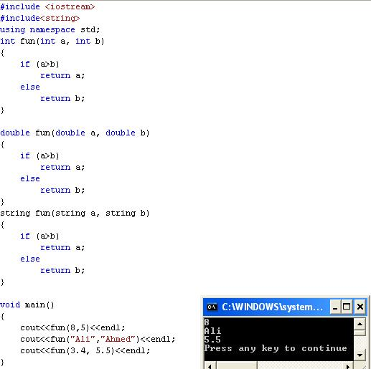
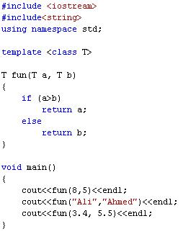

Slide 16
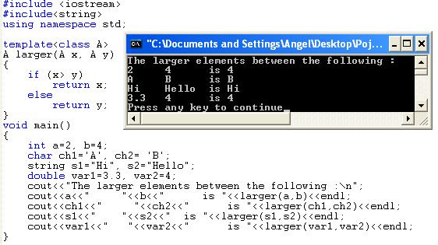
Example

Slide 17
Class Templates
Class templates: a single code segment represents a set of related classes
Syntax:
template <class Type>
class declaration
Called parameterized types
A specific class is made based on the parameter type

Slide 18
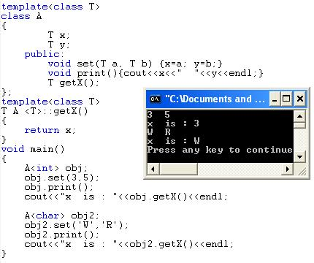
Example

Slide 19
Thanks

